Slide 1



Slide 2
What is CommerceBlock?
= Commerce on the Blockchain
CommerceBlock allows users to trade any financial instrument
on the block chain using smart contracts on a transparent, secure user interface that is enforced by the faith and trust of the bitcoin community.
CommerceBlock - September 2016

Slide 3
What is crypto-currency technology?
Bitcoin = a digital asset and P2P payment system developed in 2008 that allows users to transact directly without an intermediary
Cryptocurrency = digital currency using cryptography to secure the transactions and to control the creation of additional units of currency. Bitcoin is the first and most prominent cryptocurrency with a $10B market capitalization with trade volumes averaging $100m / day
Block chain = a public distributed ledger that verifies every bitcoin transaction user network nodes (connection points)
Smart contract = computer protocols that facilitate, verify or enforce the negotiation or performance of a contract that makes a contractual clause unnecessary
CommerceBlock - September 2016

Slide 4

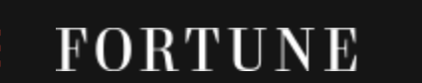
How is bitcoin technology applied to finance today?
Bitcoin technology is still relatively new but the applications of smart contracts are obvious to investment banks and Fortune 500 technology companies who have already poured substantial capital and resources to the implementation. But similar to when they built the intra-net to compete with the internet in the late 90’s, large institutions will be held back by bureaucracy, regulation and an obligation to build short-term solutions to appease shareholder demands.
BANKS
FORTUNE 500 TECH FIRMS
COMMERCE BLOCK
⌧ bank to bank transactions are not available to the public
⌧ banks are subject to heavy regulation
⌧ speed
⌧ Overly complicated
⌧ Designed specifically for the company’s target market
⌧ government regulation
☑ available to anyone
☑ open user interface
☑ simple and easy to use
CommerceBlock - September 2016

Slide 5
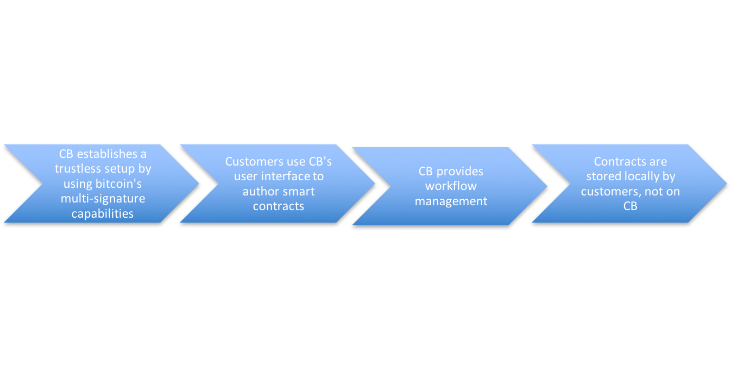

Process
⌧ lawyers
⌧ banks
⌧ government regulation
☑ optimizes logistics & information shared
☑ lower cost
☑ safe and secure
CommerceBlock - September 2016

Slide 6




Example of trade application
To buy a sugar commodity now, you must go through a registered FCM which is usually an investment bank which then sends an order to the exchange which which then requires you to post margin and clear before the trade is executed, thereby incurring countless commission costs, time and most importantly, room for error.
Futures Commission Merchant
Or “investment bank”
Trader
Exchange
Sugar producer in South Africa
With CommerceBlock, trade details are captured in a smart contract which is immediately posted on the block chain thereby saving you time & commission costs.
Trader
Sugar producer in South Africa
CommerceBlock - September 2016

Slide 7






User interface
User name: Nicholas A. Gregory
Account Balance: 9,197, 427
No. Block chain contracts: 18
MY CONTRACTS
CONTRACT NAME
CONTRACT TYPE
SIGNATORY
STATUS
ADDITIONAL DETAILS
SUGAR
100 UNITS
ALVIN SMITH
SIGNED
SIMON SMITH
PENDING
THEODORE SMITH
PENDING
MY SIGNATORIES
CONTRACT NAME
CONTRACT TYPE
CONTRACT OWNER
STATUS
ADDITIONAL DETAILS
COFFEE
50 UNITS
DAVE SMITH
SIGNED
78% completed
CommerceBlock - September 2016

Slide 8
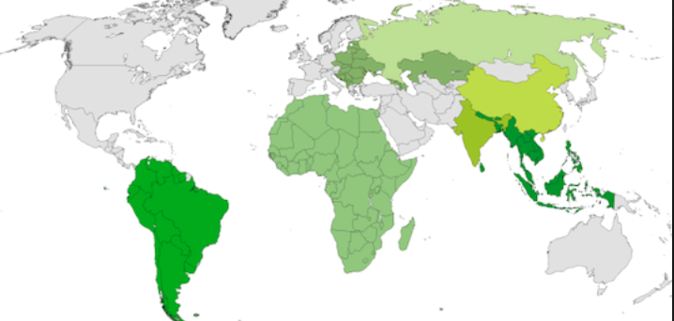
Market scope
Without the presence of a liquid and global banking system, frontier markets constitute the most immediate need and market opportunity for CommerceBlock.
The ability to seamlessly and securely trade anywhere in the world with an internet connection has infinite applications. The target Day 1 market will be emerging market finance because they are the least efficient market – under serviced by banks, most amount of intermediaries and language hurdles, which can all be resolved using CommerceBlock technology.
CommerceBlock - September 2016

Slide 9
Product development
☑ Manually built a prototype
☑ Identified bitcoin specialists and developers who can build the product
☑ Idea and prototype vetted by well known bitcoin technologists
☑ Established business plan for growth and development
☑ Currently interviewing CEO/COO positions
CommerceBlock - September 2016

Slide 10
Who are we?
Nicholas Gregory (CommerceBlock founder) is a software architect and big data expert and bitcoin aficionado. He spent the first 15 years of his career in a top global investment bank in derivatives-linked trading technology and 5 years in software development and has worked in London, New York and Hong Kong covering emerging and developed markets.
He regularly speaks at fintech disruption seminars in New York City and advises top hedge funds on crypto currency trading. In his spare time, Nicholas teaches martial arts and mentors young tech entrepreneurs.
Team also includes developers from the Buenos Ares Bitcoin center in Argentina and emerging markets commodities traders.
CommerceBlock - September 2016

